Slide 1
Out of Context Object Detection
CSE499B.11 Senior Design Project II
Group 8
Jubayer Hossain Arnob 1813124642
Fahima Noor 1912052042
Supervisor:
Mohammad Ashrafuzzaman Khan

Slide 2
What is the problem?
Image segmentation is highly valuable in fields like Robotics, Medical Imaging, and Image Recognition. With the help of image segmentation, the contents within an image can be identified and analyzed. It is also helpful in self-driving cars where identifying nearby objects on the road is crucial for autonomous driving. However, the image segmentation does not reveal much about the context between objects in a scene.
Notes:
Image segmentation is highly valuable in fields like Robotics, Medical Imaging, and Image Recognition. With the help of image segmentation, the contents within an image can be identified and analyzed. It is also helpful in self-driving cars where identifying nearby objects on the road is crucial for autonomous driving. However, the image segmentation does not reveal much about the context between objects in a scene.

Slide 3
Related works
A Tree-Based Context Model for Object Recognition(2012)
By Myung Jin Choi, Antonio Torralba, Alan S. Willsk
Context Models and Out-of-Context Objects
By Myung Jin Choi, Antonio Torralba, Alan S. Willsk
Exploiting Hierarchical Context on a Large Database of Object Categories
By Myung Jin Choi, Joseph J. Lim, Antonio Torralba, Alan S. Willsky
Content and Context Features for Scene Image Representation
By Chiranjibi Sitaula , Sunil Aryala , Yong Xianga , Anish Basnetb , Xuequan Lu
Notes:
There is not many works that has been done using this approach. However, out of context image detection has been done in the following to paper as shown. Their approach to solving the problem is different. They used tree graphical model structure to build a contextual model which was used to identify the ocd image.

Slide 4
How did we solve the problem ?
Identified what is meant by Context.
Created Out of Context Objects Dataset
Used Detectron2-identify objects in images
Used Word2Vec to find the Out of Context object
Notes:
Our task was to use the objects presented in an image to identify which of them is the out of context object. Our first step was to define what we mean by context. Here, context means image containing objects that are normally present in a scene. Since the main idea was to utilize the information of objects, for out of context images, we choose to work with those images where an object is present in situation where it should not be.
For example, it is quite normal that a sink belongs to the kitchen and not in bedroom. Similarly, you would not find food in a toilet. We understand that the present of a sink in a bedroom is out of context, but how do we make the model understand it?
To do so we needed to utilize contextual information from the objects present in the scene. We chose to work with the coco dataset, more formally known as the Common Objects in Context. The coco dataset is filled with contextual objects in various scenes which was needed for our project.
To detect objects, we chose to work with Detectron2. Detectron2 is facebook’s next generation library that provides state of the art image detection.
We trained the model on the coco dataset. We created a set of objects list that are present in each of the contextual images in coco dataset.
This list was used to train word2vec model. Word2vec model learns the word association from the large corpus of text. The word2vec model allows us to utilize the contextual relationship of the objects.
So now, if out of context images are used, the detectron2 detects the out of context images and outputs the objects found in the image. This output is then passed to the word2vec, were it analyses the relationship between the words given to it, and finds out the odd one out.

Slide 5
What challenges did we face?
Using PSPNET to detect OCO in images
Detectron2 not accurately identifying vehicles
Limitations of COCO dataset
Limitations of Google Colaboratory
Oversampling of certain words such as “person” and “wall”
Notes:
Firstly, we chose PSPNET as our image detection model. The reason was simple. PSPNET had a high object detection accuracy. Unfortunately, the way PSPNET worked was not suitable for the project. The model performed excellently for contextual images, it performed worse for out of context images. The reason why it performed poorly in Out of context image dataset is because it was a semantic model where it utilized its surrounding to make the prediction of the object. In out of context images, the object that is out of context and the scene where it is opposes each other. Thus is becomes harder for PSPNET to make detection for Out of context objects.
Thus we planed to work with Dectron2. The problem with detectron2 is that it is not as highly efficient in detecting vehicles. It tends to make mistakes in properly identifying vehicles. Other than that, it has a high accuracy in predicting objects correctly. Detectron2 works better in detecting Out of context images better than PSPNET.
We used word2vec model to build a contextual model. However, oversampling of certain words such as person and wall can hinder the accuracy of the model.

Slide 6
How teamwork played roles in solving the problem?
Creating OCO Dataset
Creating COCO17_OL Dataset
Refining Word2Vec model
Notes:
Since we had to work on immense amount of dataset, having teammate made it easier. We were able to create contextual dataset quickly. We could simultaneously work on creating OCD dataset as well as training and refinining the performance of word2vec model.

Slide 7
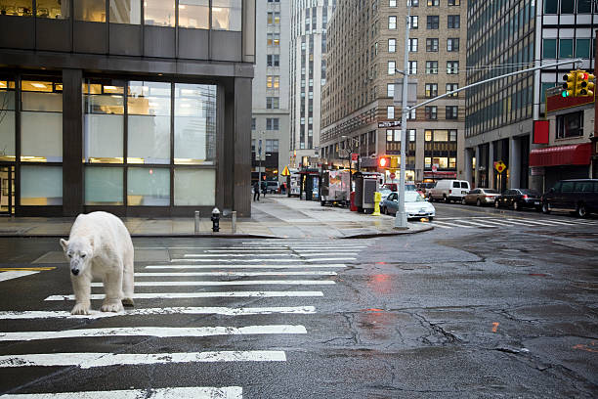
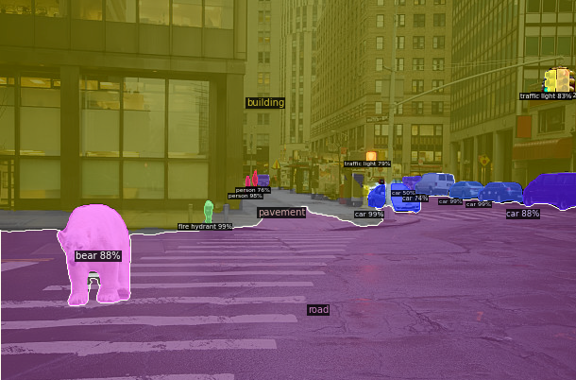

Conclusion
Accuracy of OCO Detection: 88%
The Out of Context objects are successfully identified by Word2vec model
Notes:
The accuracy of the word2vec model in detecting the Out of context object is around %. It shows that the model is good in identifying the relationship between different words. For the project, we utilized Detectron2 and Word2vec model to identify objects violating contextual scene. This work can be useful in task where monitoring of contextual scene is neccessary.

